Slide 1
IFTTT Project 5
Ben Sottile

Slide 2
Solve A Problem That Fits your Immediate Needs
I’m a forgetful person.
I thought up two applets that were helpful.
So I made two IFTTT Applets to help me with a problem

Slide 3
Call my device
I connected a triggerable google drive folder that I can trigger from my computer.
The call will be placed whenever I place a document in the caller folder with the message placed in the file
This allows me to call and find my phone from my computer but also allow for the ability to pass on a prerecorded message if need be

Slide 4
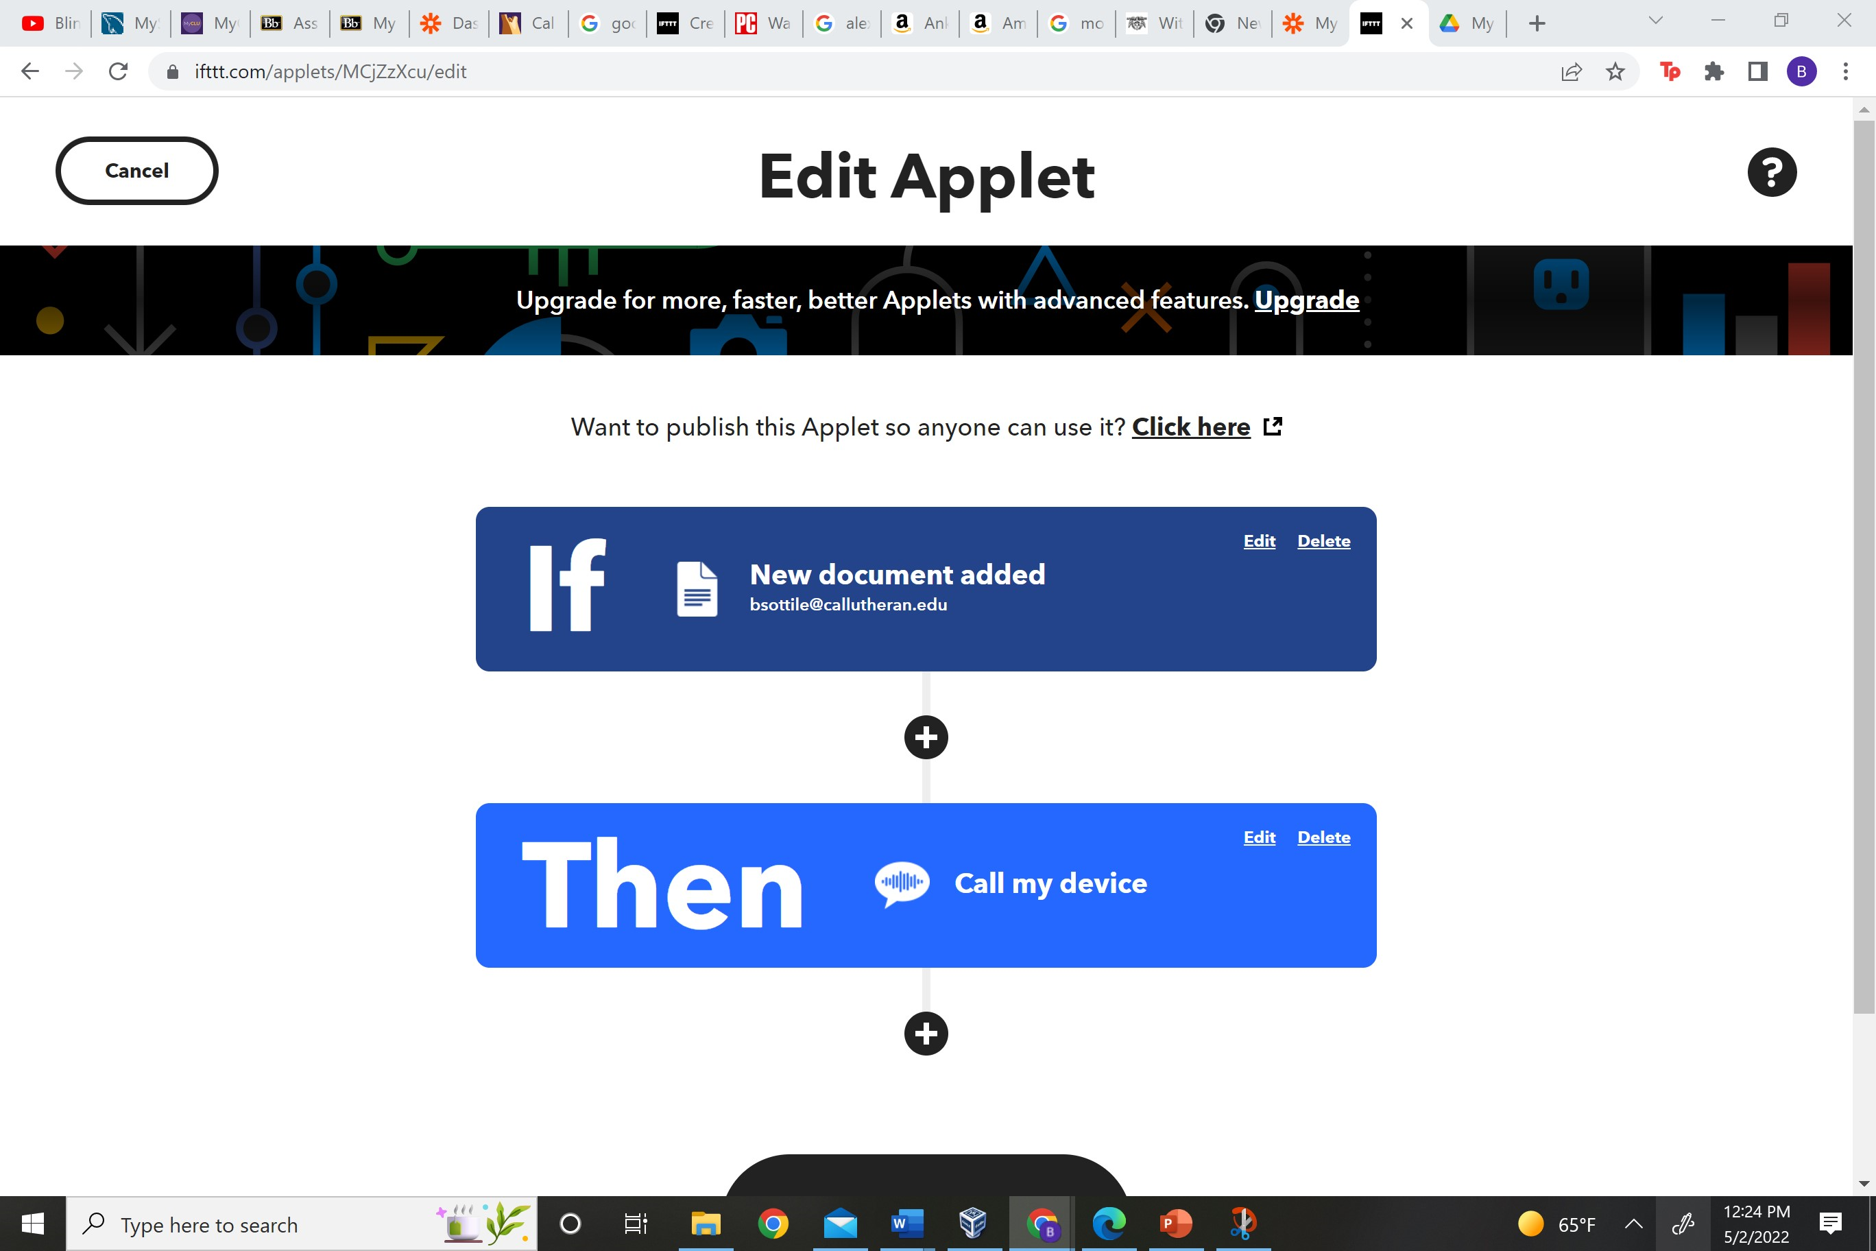
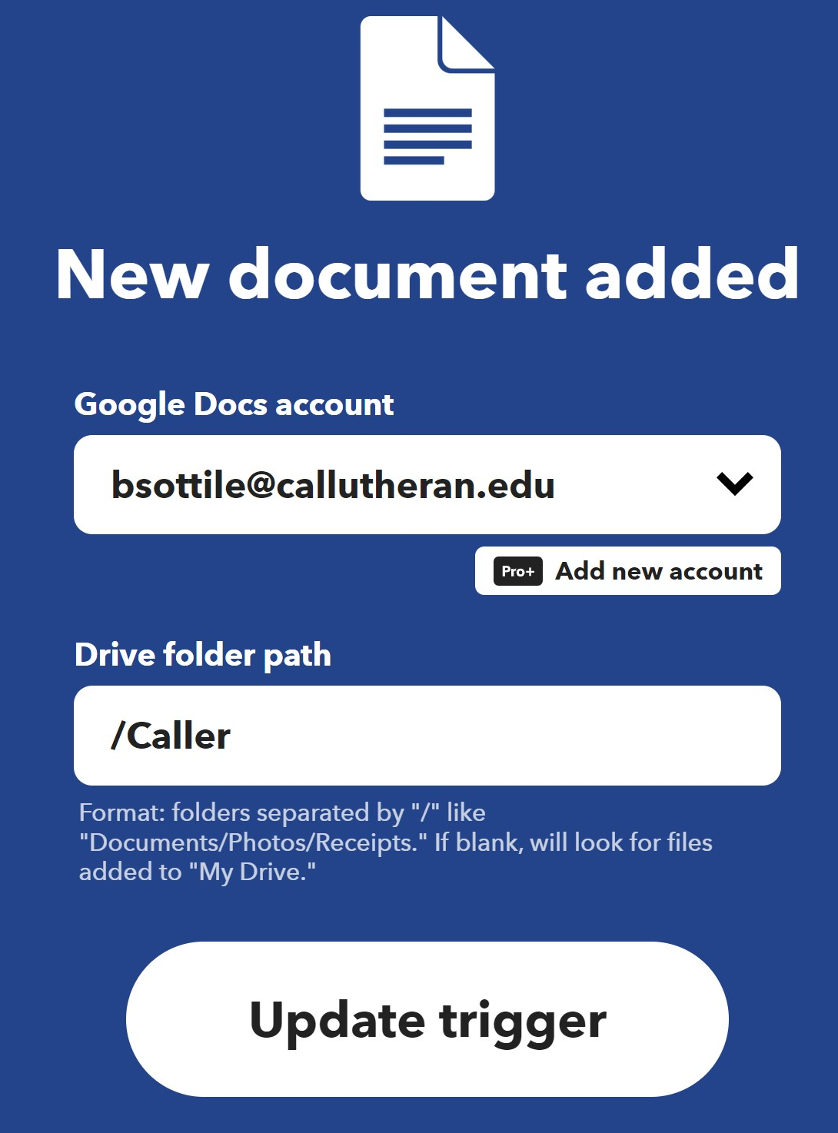
No-code “code”

Slide 5
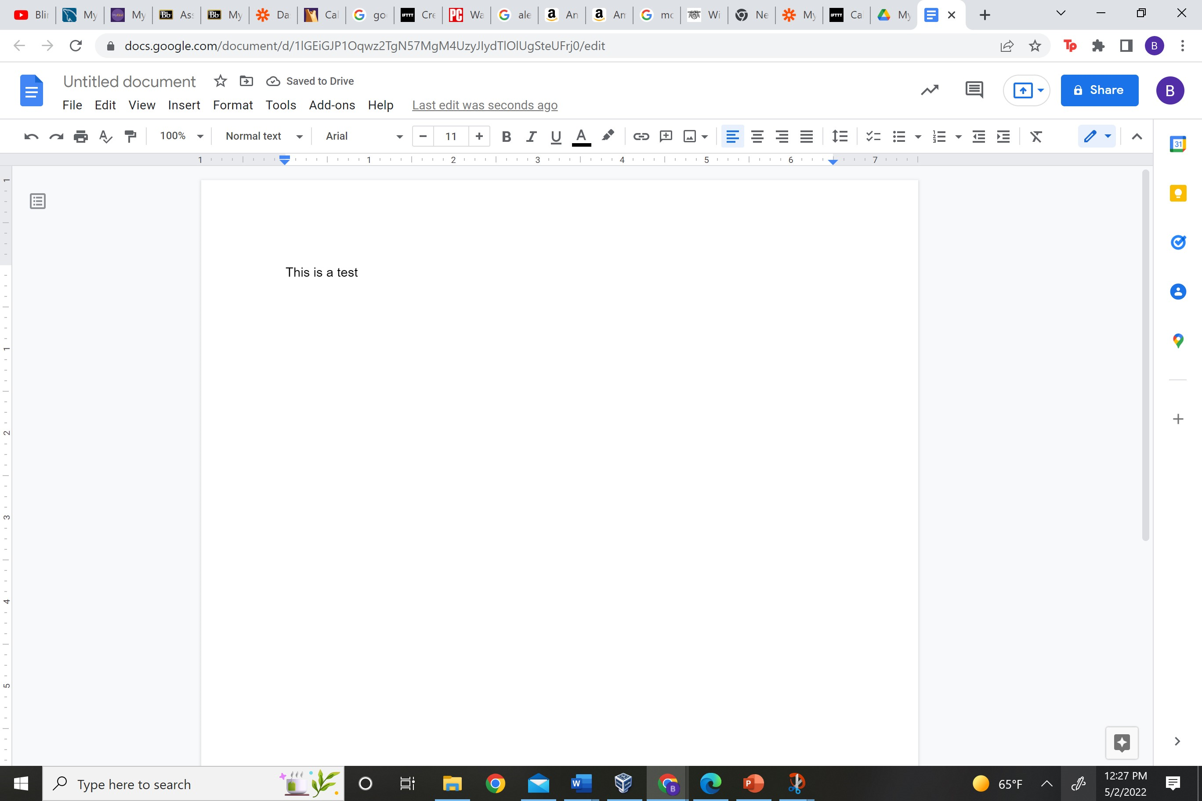
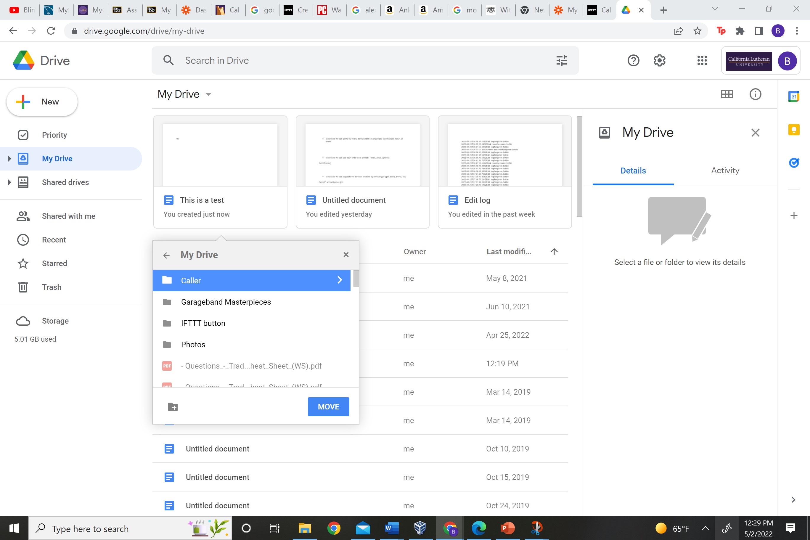
Test

Slide 6
Eh, its kind of useless
IFTTT applets that check for something only run once an hour
So it doesn’t immediately call my phone like I hope

Slide 7
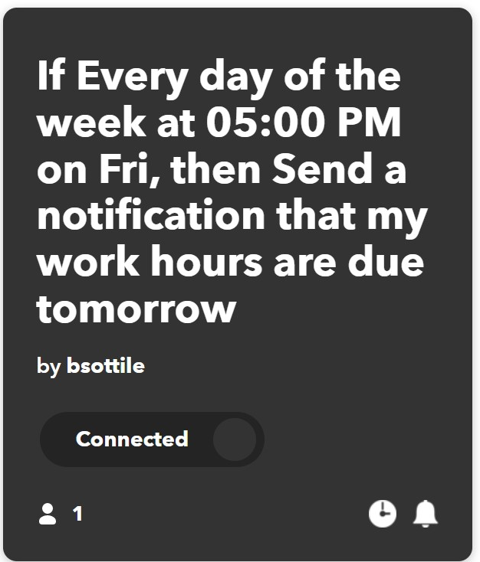
2nd App Timesheet Automatic Notification
So I always forget my timesheet and to set notification to remind me of my time sheet so I used IFTTT to automate it for me

Slide 8
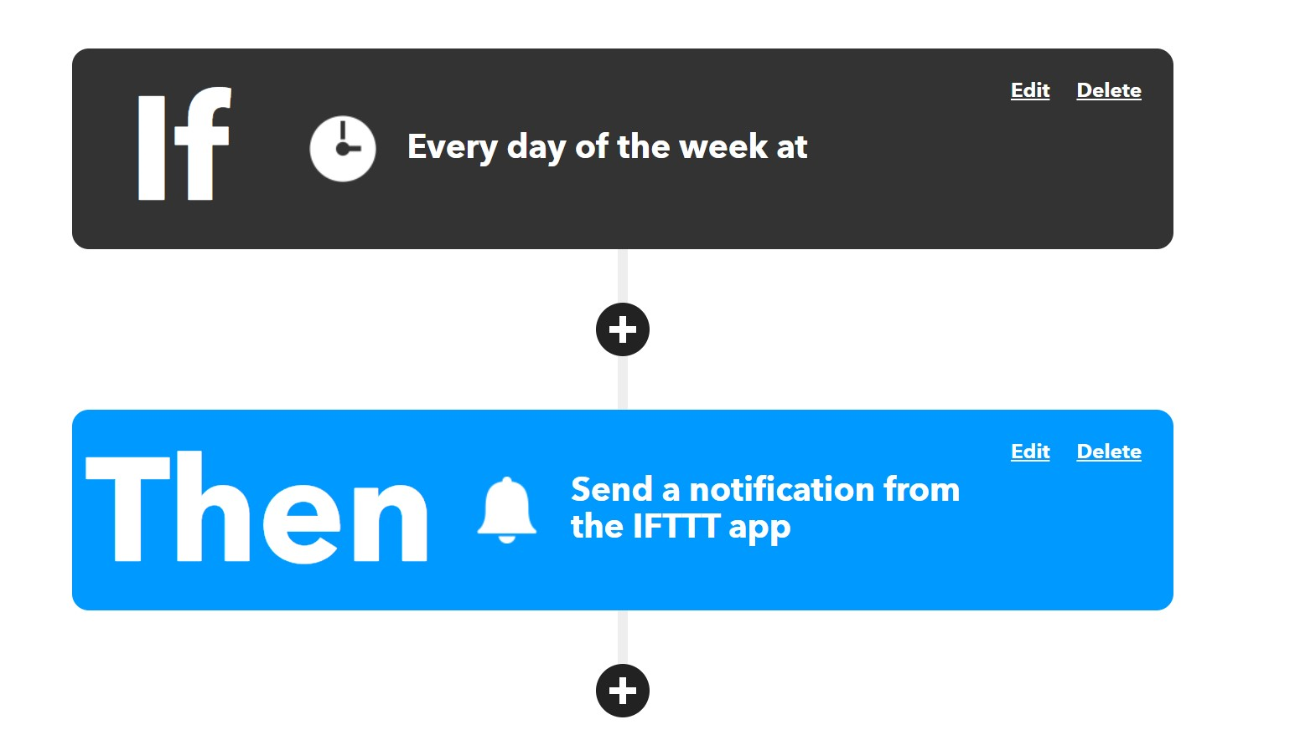
No-Code “Code”

Slide 9
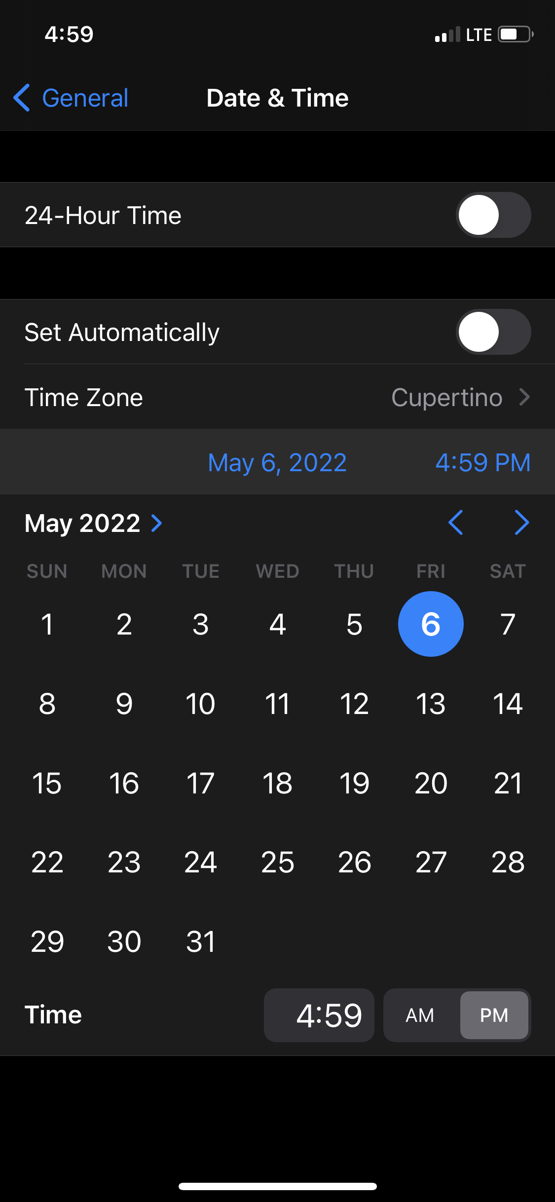
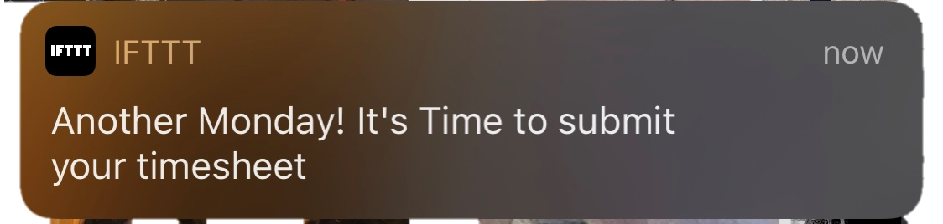
Test
Test # 1: Faliure
Test #2: Success
I tried it the first time by altering my iPhone time which didn’t work because date and time doesn’t use your phones time. I then ran it by changing it on the actual applet and I got the test to work.
How wonderful another notification…

Slide 10
Sources
https://ifttt.com/applets/aWp5SRFE/edit

